Slide 1


DEPARTMENT OF COMPUTER SCIENCE AND ENGINEERING
20CS8504 & PROJECT WORK
END SEMESTER PRACTICAL EXAMINATION - APRIL/MAY - 2026
Batch No.: 3
Date: 05-05-2026
Session: FN

Slide 2
WIFI INTRUSION DETECTION SYSTEM
Guide Name:
Mrs.M.Suriya,M.E.,
Assistant Professor
Department of CSE
Team Members:
Rajev shree U(2303811710422130)
Shajathi bee M (2303811710422141)
Shibani S (2303811710422147)
Sowmiyaa VS (2303811710422154)

Slide 3
OBJECTIVE OF THE PROJECT
To develop a system that scans and displays all nearby Wi-Fi networks in real time. To detect fake or duplicate networks (rogue access points) using SSID analysis. To classify networks into SAFE, MEDIUM, and HIGH risk categories. To implement secure user authentication using login and OTP verification. To design an interactive web dashboard for monitoring and alerting users about potential threats.

Slide 4
INTRODUCTION
Wireless networks (Wi-Fi) are widely used for communication, but they are highly vulnerable to security threats such as unauthorized access and fake access points. Attackers can create rogue or duplicate Wi-Fi networks (evil twin attacks) to steal sensitive information from users. Traditional security mechanisms like passwords alone are not sufficient to detect such network-level threats. A real-time monitoring system is required to continuously scan and analyze nearby Wi-Fi networks. This project introduces a Wi-Fi Intrusion Detection System that identifies suspicious networks and provides a user-friendly dashboard for security awareness.

Slide 5
LITERATURE SURVEY
TITLE OF PAPER | AUTHORS | PAPER GIST | TECHNOLOGY USED
A Survey of Intrusion Detection Systems in Wireless Networks | W LEE | This paper provides a comprehensive survey of intrusion detection systems (IDS) specifically designed for wireless networks. | Intrusion Detection Systems (IDS) Wireless Network Protocols
Detecting Rogue Access Points Using Signal Strength and Network Monitoring | J.WRIGHT | This paper explains methods to detect rogue access points (fake Wi-Fi networks) using signal strength and network behavior analysis. | Signal Strength Analysis Wireless Packet Monitoring
Anomaly-Based Intrusion Detection in Wireless Networks | G.VIGNA | This paper proposes an anomaly-based approach for detecting intrusions in wireless networks. | Anomaly Detection Statistical Modeling
Wireless Network Security: Threats and Countermeasures | A.MISHRA | This paper discusses various security threats in wireless networks, including eavesdropping, spoofing, and rogue access points. | Encryption Protocols (WEP, WPA, WPA2) Authentication Mechanisms
Design and Implementation of a Real-Time Network Monitoring System | M.ROESCH | This paper presents the design of a real-time network monitoring system capable of detecting suspicious activities and generating alerts | Network Monitoring Systems Intrusion Detection Tools (Snort)

Slide 6
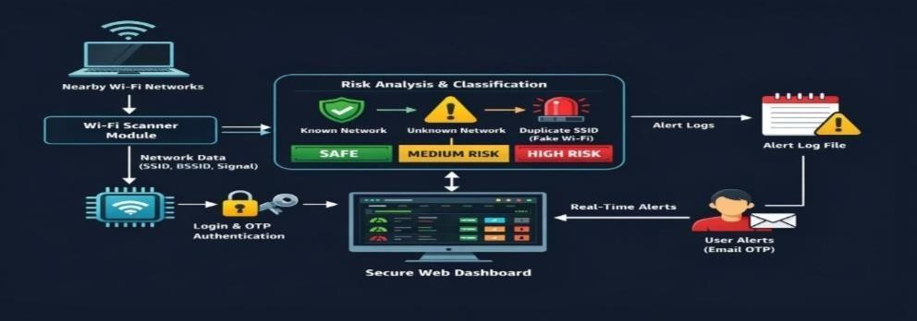
EXISTING SYSTEM

Slide 7
PROBLEM IDENTIFICAITON
Wi-Fi networks are vulnerable to unauthorized access and cyber attacks.
Users cannot easily identify fake or rogue access points.Lack of real-time monitoring for nearby wireless networks.
Existing security methods do not detect duplicate SSIDs (evil twin attacks).
No simple and user-friendly system to visualize Wi-Fi security risks.

Slide 8
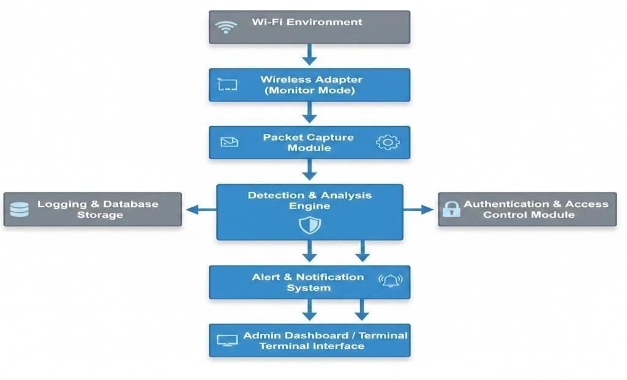
PROPOSED SYSTEM ARCHITECTURE

Slide 9
SOFTWARE AND HARDWARE REQUIREMENTS
HARDWARE
Computer/Laptop with Wi-Fi adapter Processor (Intel i3 or higher) Minimum 4 GB RAM Storage (at least 20 GB free space) Network Interface Card (Wireless support)
SOFTWARE
Operating System (Linux preferred / Windows with support tools) Python (3.x version) Flask Framework Network tools (nmcli / system command utilities) Web technologies (HTML, CSS for frontend)

Slide 10
MODULES
User Authentication Module Wi-Fi Scanning Module Risk Analysis & Detection Module Alert Logging Module Web Dashboard & Visualization Module

Slide 11
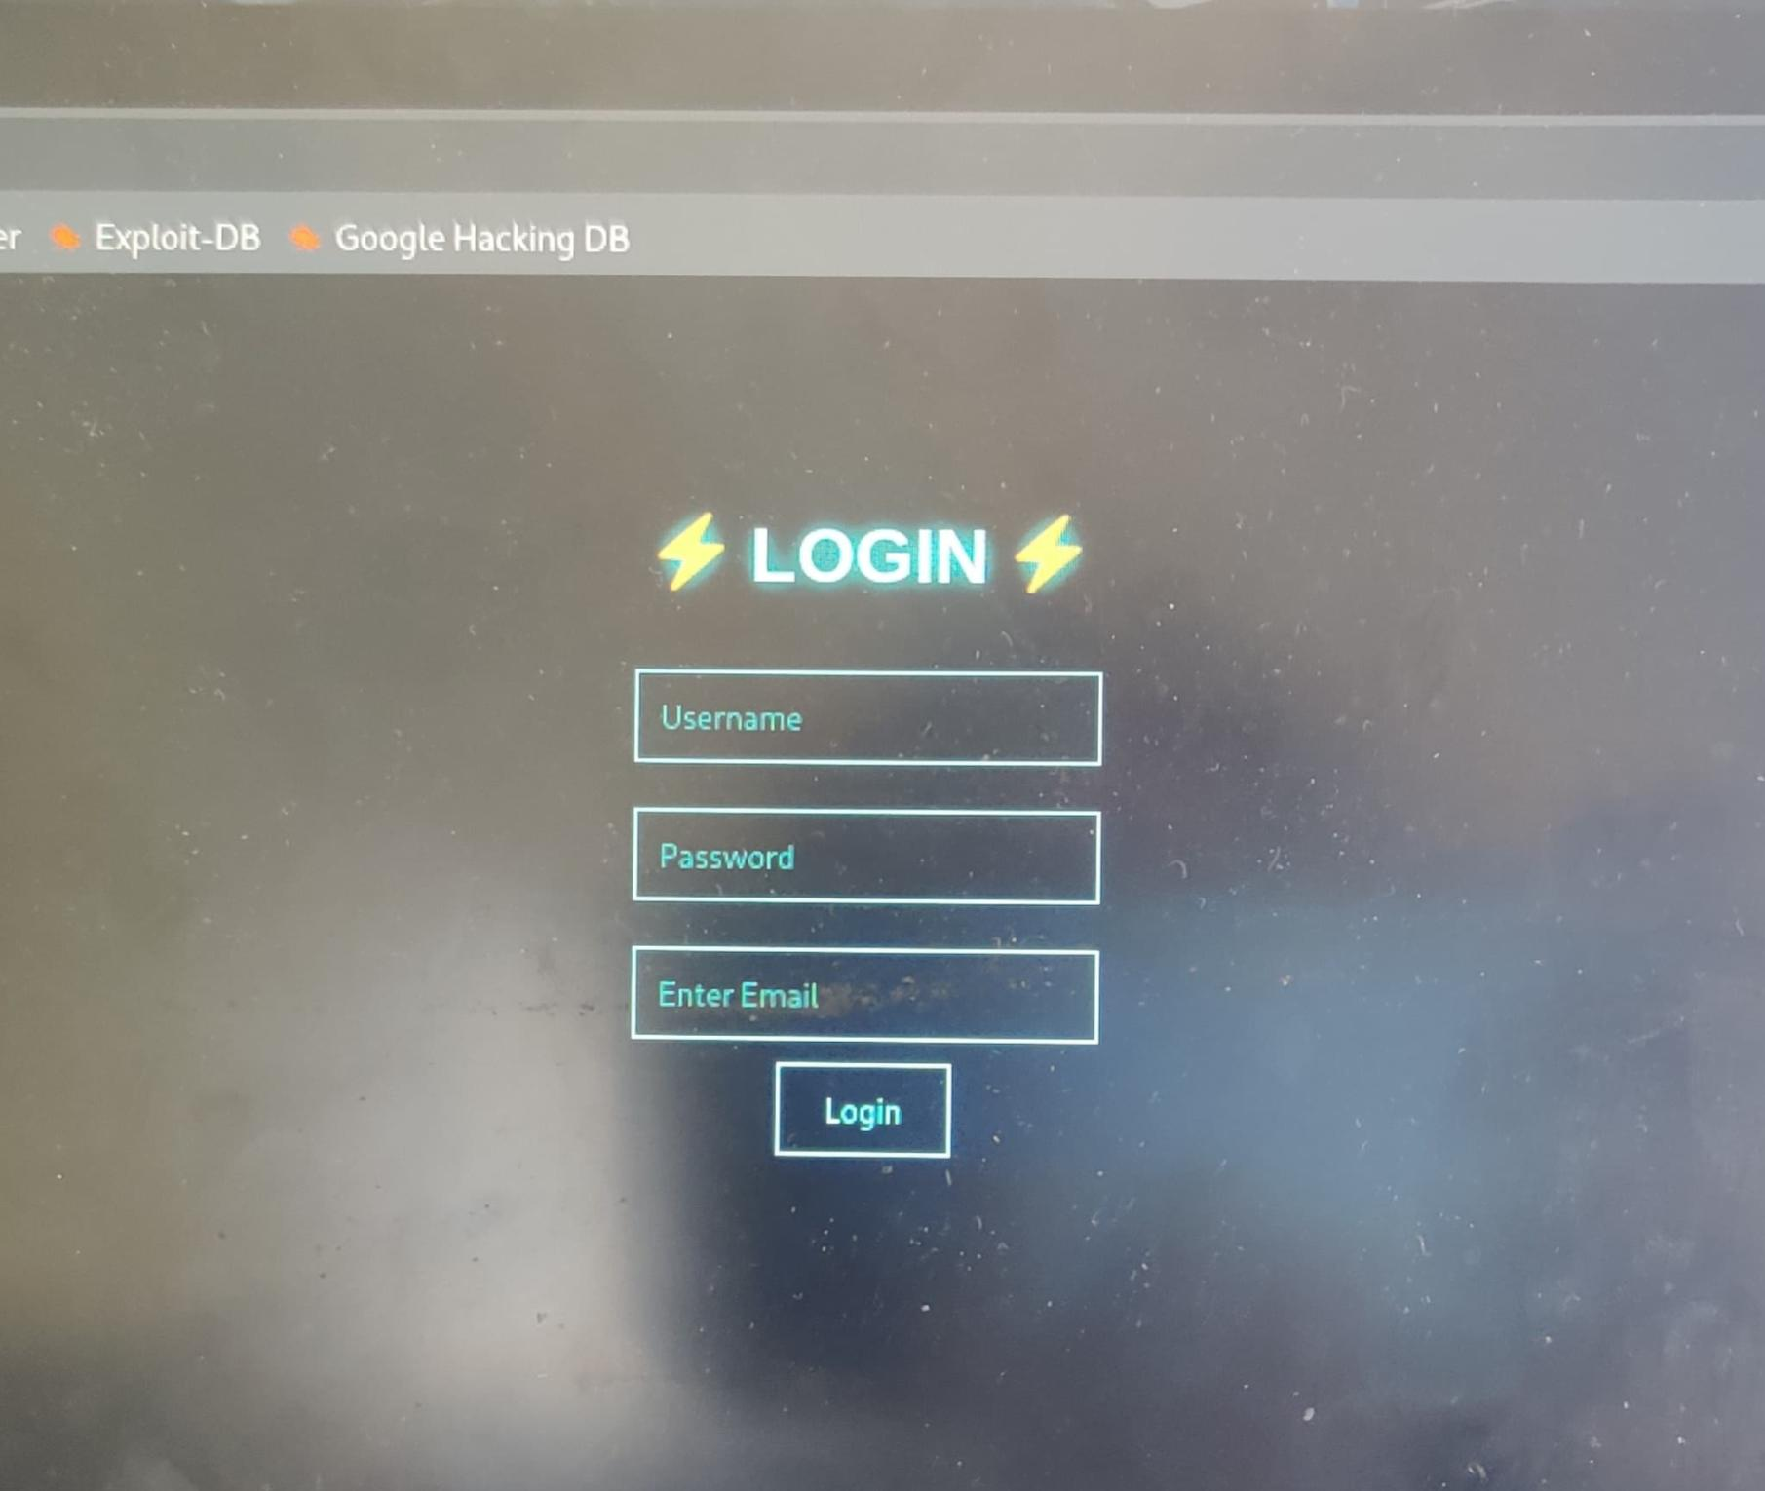
IMPLEMENTATION OF MODULE-1
Fixed login credentials validation OTP generation using random numbers Email-based OTP verification Session management using Flask

Slide 12
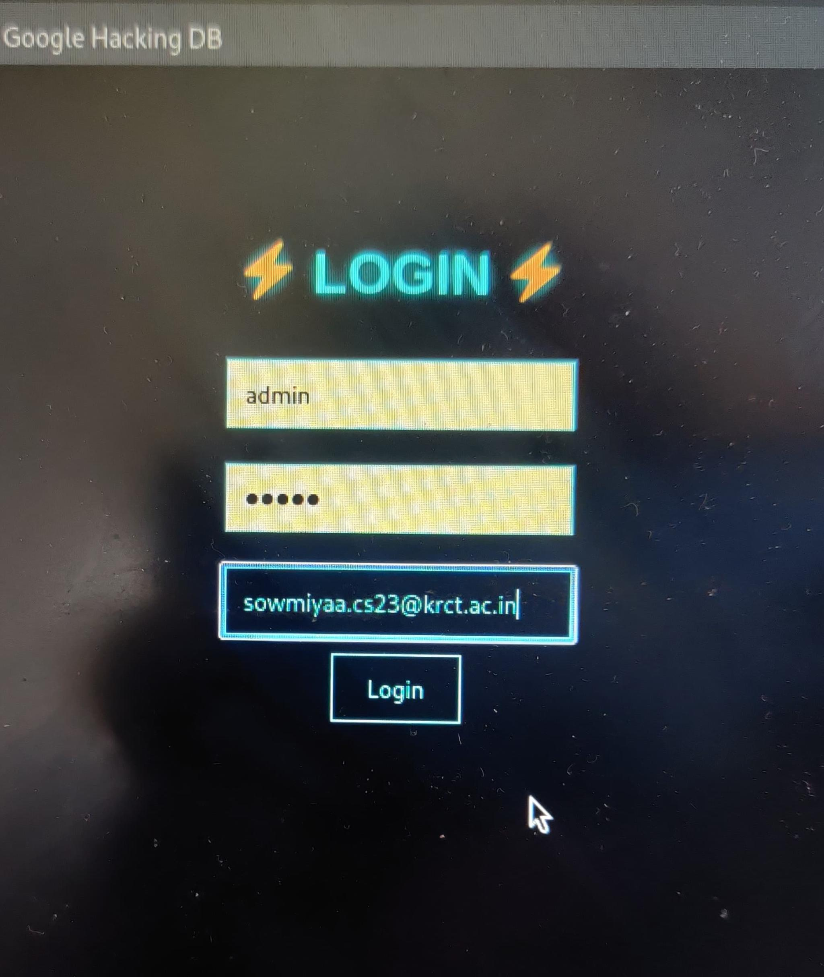
IMPLEMENTATION OF MODULE-2
Uses nmcli command to scan networks Extracts SSID, BSSID, and signal strength Removes duplicate entries Timestamp for each scan

Slide 13
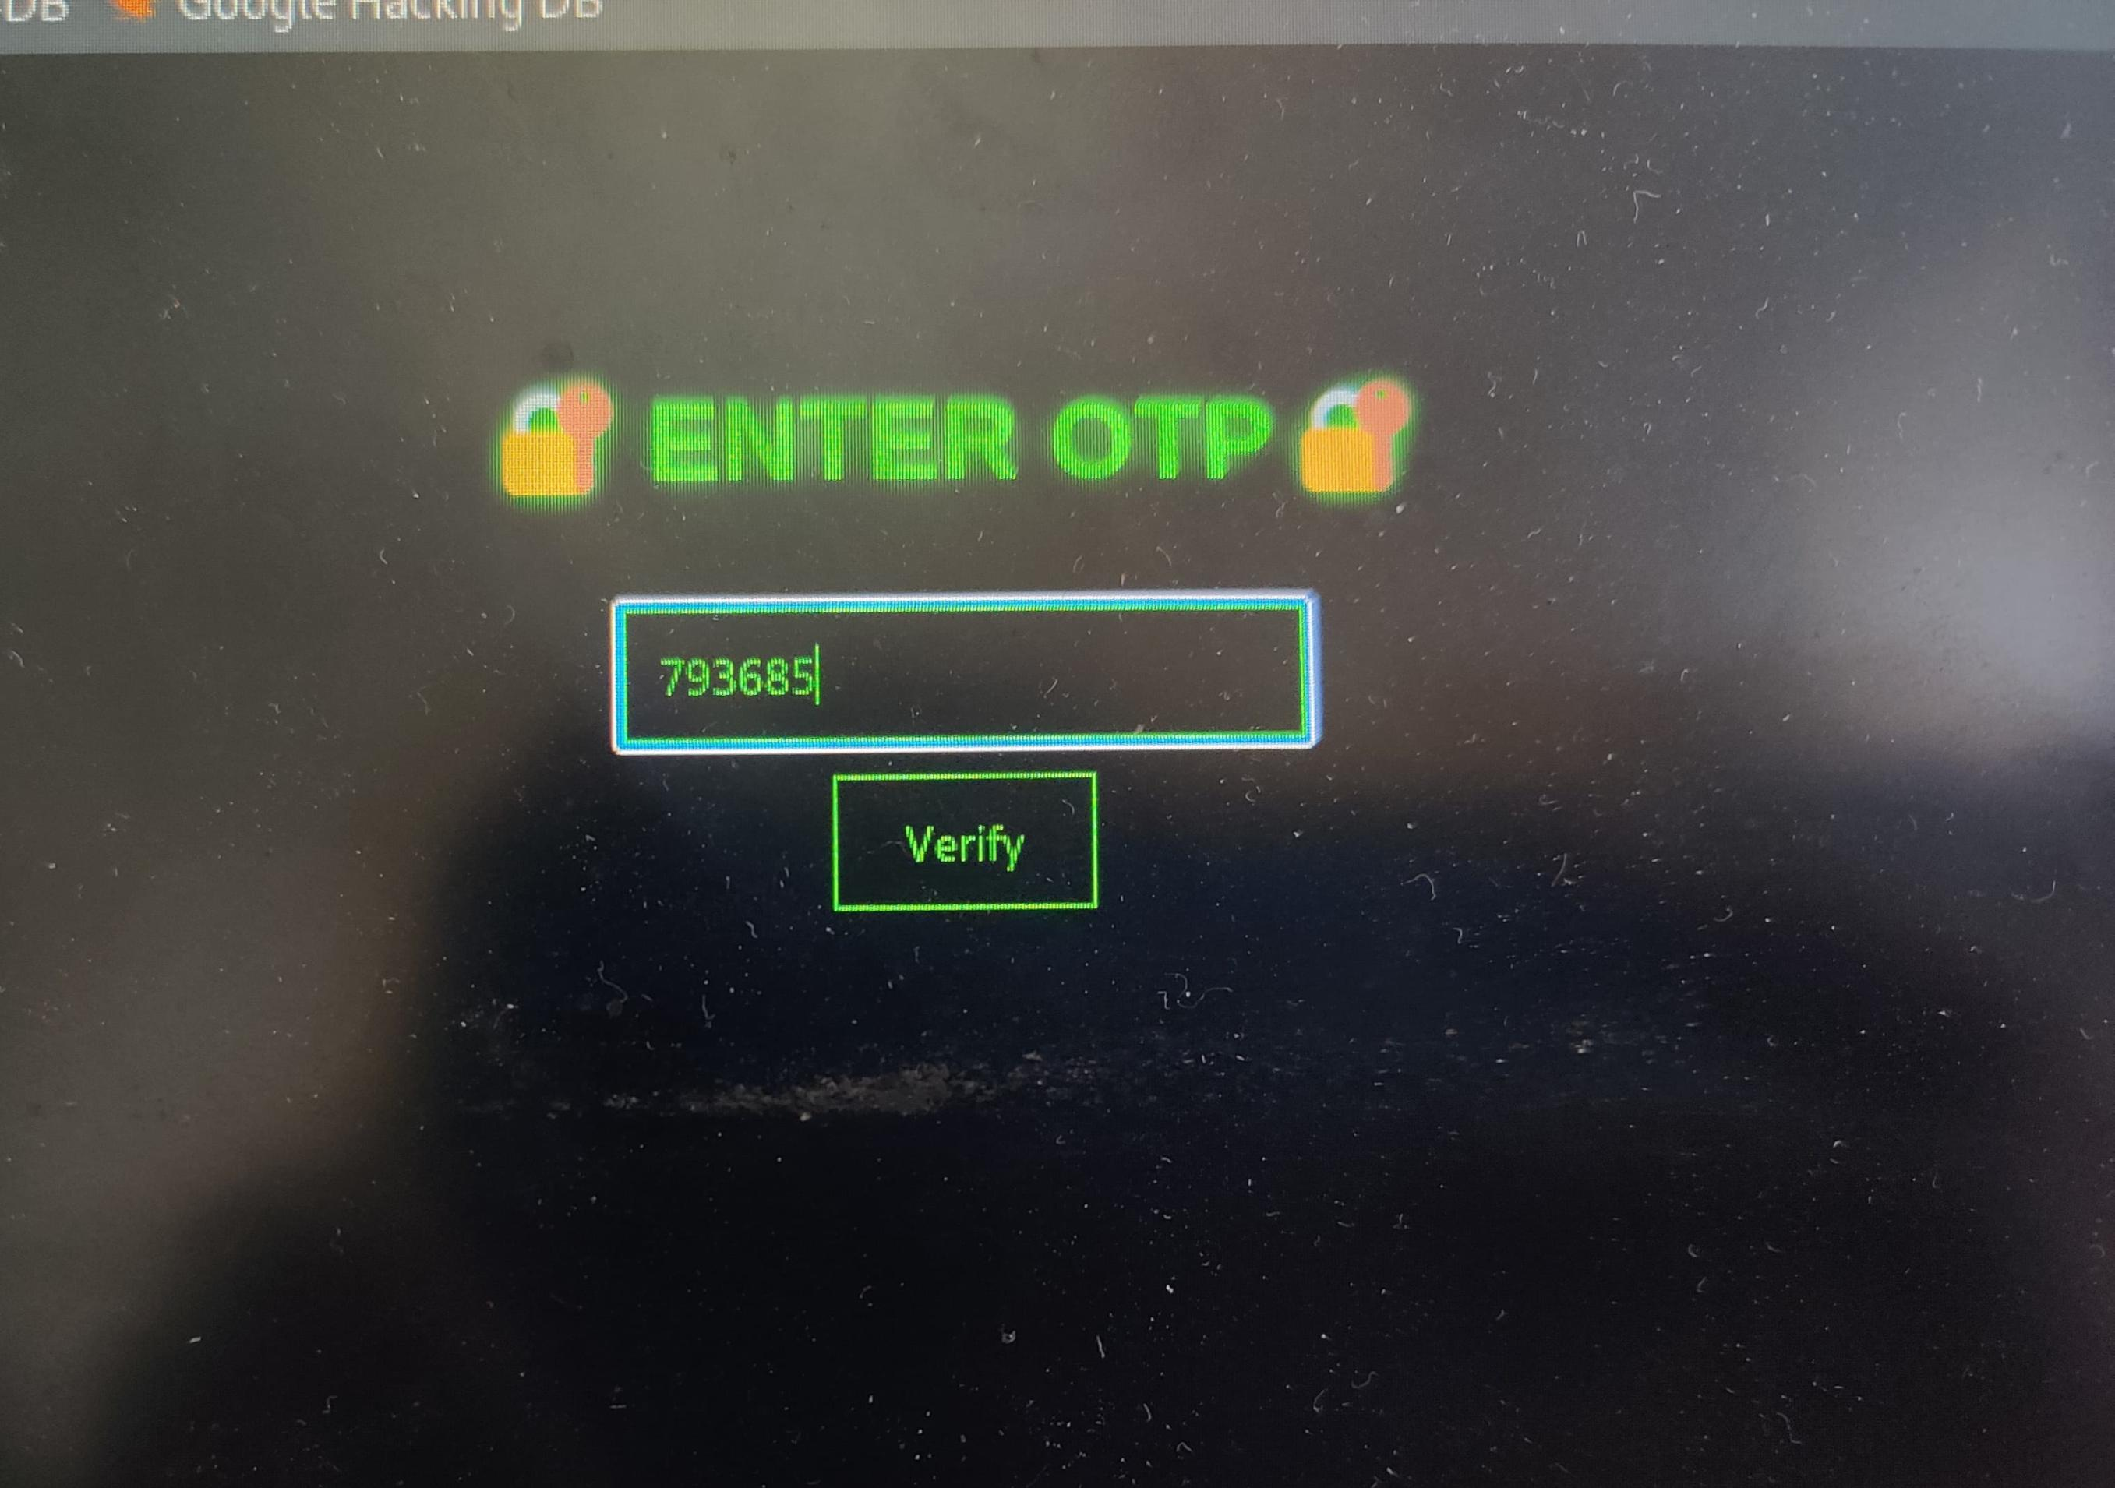
IMPLEMENTATION OF MODULE-3
Detects duplicate SSIDs (possible fake/evil twin attack) Compares networks with known Wi-Fi list Classifies signal strength (Strong, Medium, Weak) Generates alerts for suspicious networks

Slide 14
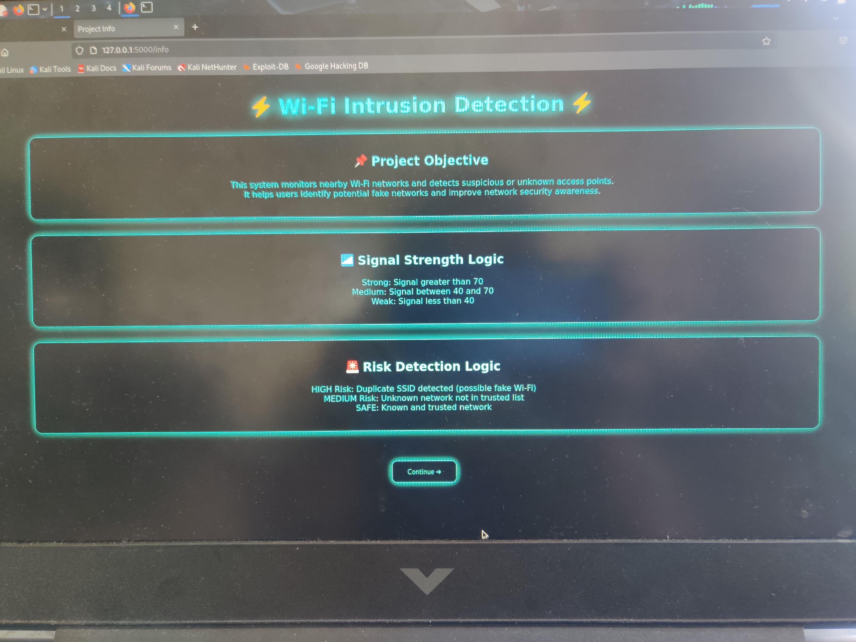
IMPLEMENTATION OF MODULE-4
Logs unknown networks Logs fake Wi-Fi detection Stores timestamped alerts in wifi_alert_log.txt Updates logs dynamically

Slide 15
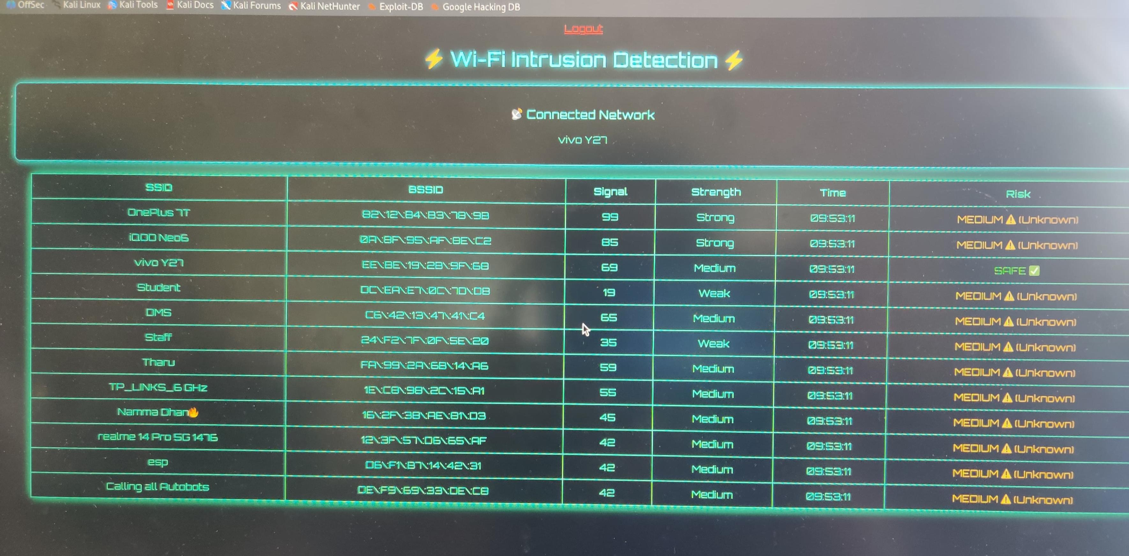
IMPLEMENTATION OF MODULE-5
Dynamic dashboard using Flask + HTML Auto-refresh every 5 seconds Displays connected Wi-Fi network Color-coded risk levels (Safe, Medium, High) Table view for all networks

Slide 16
CONCLUSION
The Wi-Fi Intrusion Detection System successfully provides a real-time solution for monitoring nearby wireless networks and identifying potential security threats.
By combining Wi-Fi scanning, risk classification, and a user-friendly web dashboard, the system helps users easily detect unknown and potentially malicious networks such as fake access points.
The integration of authentication with OTP enhances security, ensuring that only authorized users can access the system.
Overall, the project demonstrates an effective approach to improving wireless network awareness and security using simple yet powerful tools.

Slide 17
FUTURE ENHANCEMENTS
Real-time Notifications: Send instant alerts via mobile apps or SMS when a high-risk network is detected.
MachineLearning Integration: Use AI models to improve accuracy in detecting suspicious networks and behavior patterns
Automatic Blocking: Integrate firewall or system-level controls to automatically block connections to unsafe networks.
Mobile Application: Develop an Android/iOS app for easier and portable monitoring.
Geolocation Tracking: Map detected Wi-Fi networks to visualize their physical locations.

